Slide 1
CMPSC 480
Software Innovation 1

Slide 2
Assignment #1 Peer Review
I have paired you with another student in the class. Some are members of groups of 3.
Read each others’ narratives. This will require:
Giving access to or copies of the files to your group.
Achieve this using GitHub, email, Slack, or Google Drive. Any combination thereof works.
When groups have settled, I will post a list of questions and areas of interest for readers/reviewers to consider.

Slide 3
OPENING
Is the opening statement clear, concise and descriptive?
What suggestions could you make to condense or distill the writer’s description?
SPECIFIC PERSONAL STORY
What is the relationship between this story and the writer’s “Opening?”
Is it clear why the writer defines themselves as a Developer researching compression formats (for example)?
Given that this is a story, are there details which give the reader a sense of the importance/significance of this particular experience?
TRANSFERABLE SKILLS
Are the skills listed here something that the writer could easily demonstrate?
Are these skills applicable to the teaching, practice, or research of computer science-related topics?
What skills don’t belong here, or what skills might you have expected to see, but are missing?
SUPPORTING EXPERIENCE
Do these stories relate how specific skills were learned, applied, or practiced?
Do details provide enough of a “story” for a reader to understand the writer’s use or development of the skill?
ENDING & TITLE
Do to the “Title” and “Ending” sections communicate the same message? If not, how is each different? What advice can you provide?
What is their relationship the other parts of the document?

Slide 4
Something to keep an eye on
Your site will need to include at least one (1) software project
If you have one that you’d like to revise or “clean up,” start thinking about how you’d like to present it or use it
If you don’t have a project to share, begin thinking about how you can at least start to develop one
For some of you, software projects may not be the correct “vehicle” (I think here mostly of those interested in teaching)

Slide 5
Résumés
Different types:
Chronological
Lists work history in reverse time order (latest first)
Most common
Leverages:
Work history
Work achievements
Functional
To address potential lack of work experience, leverages:
projects
skills,
other transferable, concrete knowledge

Slide 6
Résumés
Combination
Format for those between a functional and chronological résumé
Foregrounds skills (roughly ½ a page)
Lists experience chronologically (rougly ½ a page)
Curriculum Vitae
Format for those who work either abroad (in some cases) or in disciplines which value other things than just work experience
Often foregrounds education and participation in a discipline over working experience

Slide 7
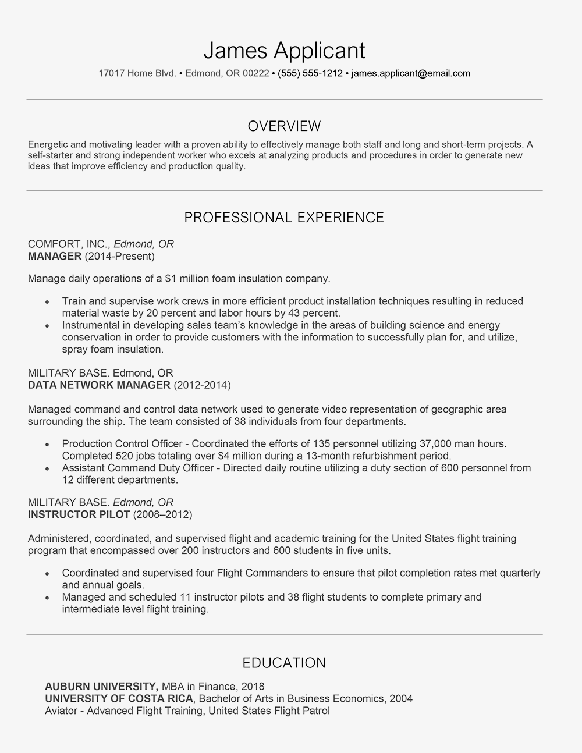
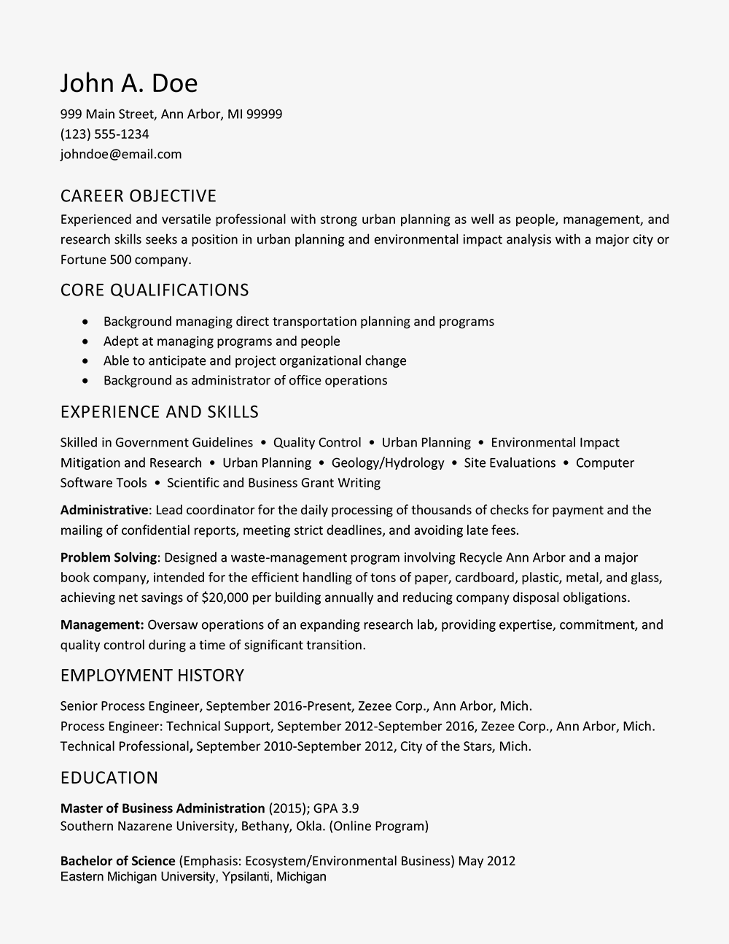

Slide 8
